Slide 1

Basics of Neural Network Programming
Vectorization
deeplearning.ai

Slide 2
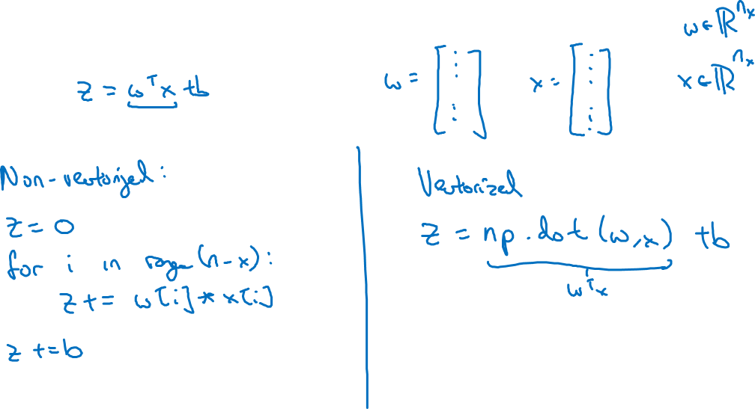
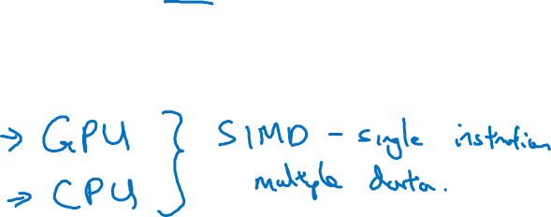
What is vectorization?

Slide 3
Basics of Neural Network Programming
More vectorization
examples
deeplearning.ai

Slide 4
Neural network programming guideline
Whenever possible, avoid explicit for-loops.

Slide 5
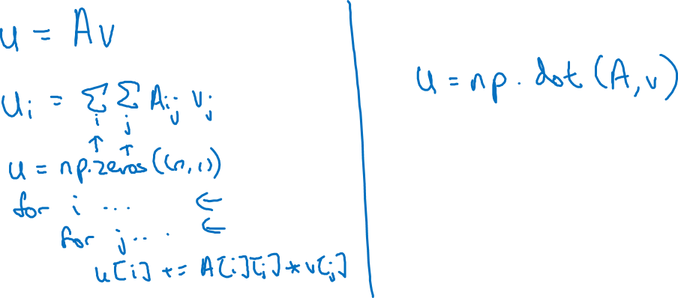
Neural network programming guideline
Whenever possible, avoid explicit for-loops.

Slide 6
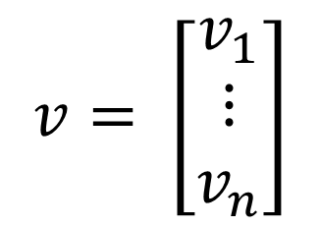
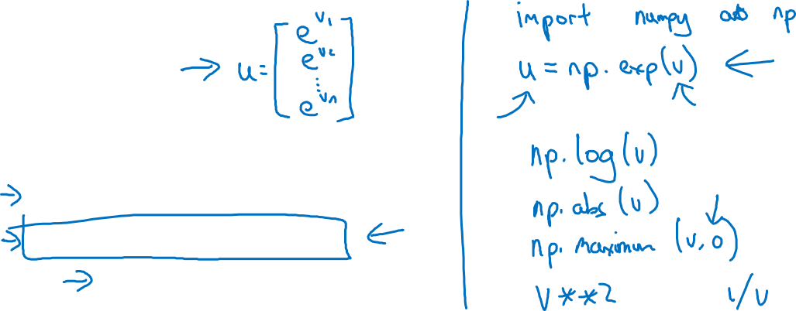
Vectors and matrix valued functions
Say you need to apply the exponential operation on every element of a matrix/vector.
$$v= \left[\begin{matrix}v_{1} \\ ⋮ \\ v_{n}\end{matrix}\right]$$
u = np.zeros((n,1))
for i in range(n):
u[i]=math.exp(v[i])

Slide 7

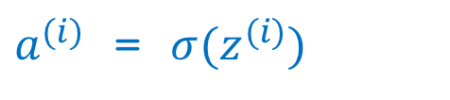
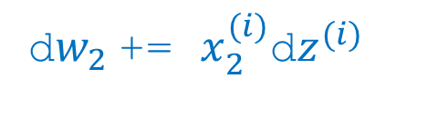
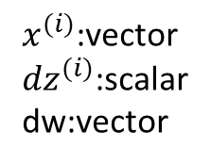
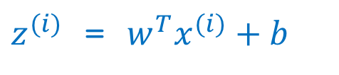
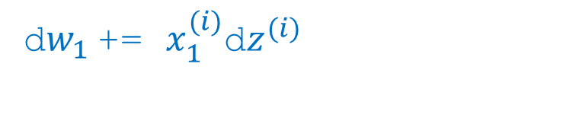
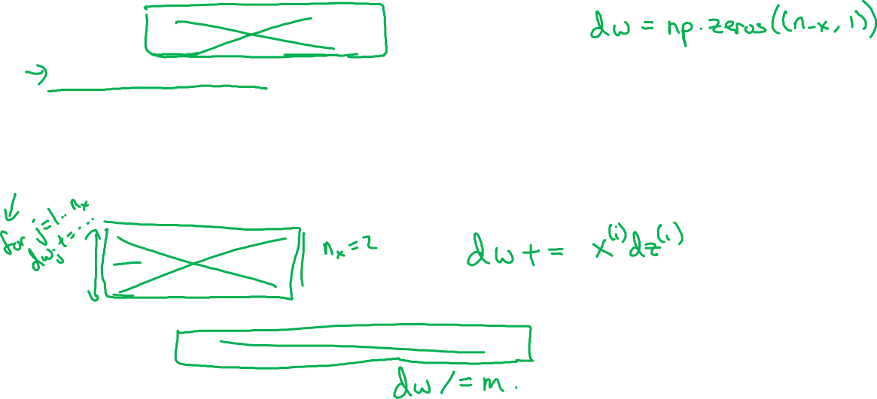
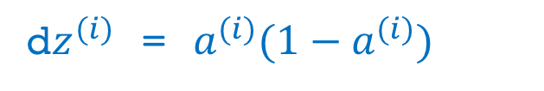
Logistic regression derivatives
J = 0, dw1 = 0, dw2 = 0, db = 0
for i = 1 to n:
$z^{(i)}$ = $w^{T}x^{(i)}+b$
$a^{(i)}$ = $σ{(z}^{(i)})$
$J$+= $−\left[y^{(i)} \log{{\hat{y}}^{\left(i\right)}+({1−y}^{\left(i\right)})\log{(1 −{\hat{y}}^{\left(i\right)})}}\right]$
d$z^{(i)}$ = $a^{(i)}{(1−a}^{(i)})$
d${w_{1}}^{ }$+= $x_{1}^{(i)}\text{d}z^{(i)}$
$x^{(i)}$:vector
${dz}^{(i)}$:scalar
dw:vector
d${w_{2}}^{ }$+= $x_{2}^{(i)}\text{d}z^{(i)}$
db += d$z^{(i)}$
J = J/m, d$w_{1}$ = d$w_{1}$/m, d$w_{2}$ = d$w_{2}$/m, db = db/m

